Slide 1
Story time phonics
Wheatfields Primary School

Slide 2
What is phonics?
Phonics is the first strategy that children are taught in helping them to learn to read. It runs along side other teaching methods such as guided reading and shared reading to help develop all the vital skills that will hopefully give them a love of reading.

Slide 3
The expectation
Every child is taught how to learn to read through phonics from EYFS through to Year 2.
At Wheatfields we use the Story Time Phonics scheme of work which is new to us this year.
Every EYFS and Year 1 class will have a daily 30 minutes phonics lesson.
For those who need extra help and support this is given through extra reading with adults and interventions with our LSAs and teaching staff.
By the end of EYFS the children are expected to know all of their phase 3 sounds to give them a strong foundation to learn their phase 5 sounds in Year 1. This leads on to Year 2 spelling rules.

Slide 4
Government expectation
During the summer term all the children within Year 1 will take the Phonic Screen Check.
This consist of reading 40 words that contain all the sounds that they have been taught through EYFS and Y1. The words are a mixture of pseudo (real) and non- pseudo (not real) words.
This is a Government expectation however the children’s teachers will administer the check next summer.
The result has no baring on your child in their future academic progression, however if they do not meet the pass mark in the check, we will give them additional support to assist their learning when they reach Year 2.

Slide 5
Phonic screening check

Slide 6
What we do at Wheatfields…
As of this year we have purchased and instigated a new scheme – Story Time phonics. This new scheme of work spans EYFS through to Year 1 so the teachers can track/assess children’s progression within phonics.
Story time phonics uses books to teach the 40+ phonemes and their grapheme correspondence.
The philosophy behind story time phonics
Fun and creative activities to develop a love of reading
The children hear the sounds in context
They are exposed to language through a wide range of books
A solid based for decoding (identifying individual sounds in words). CHIP – CH…I…P

Slide 7
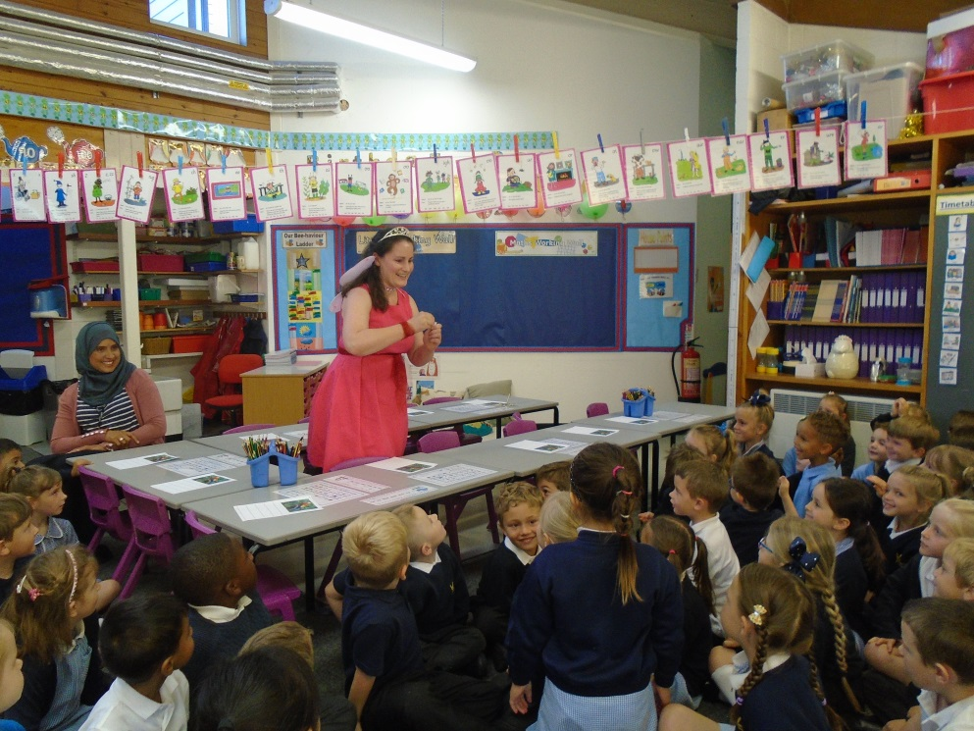
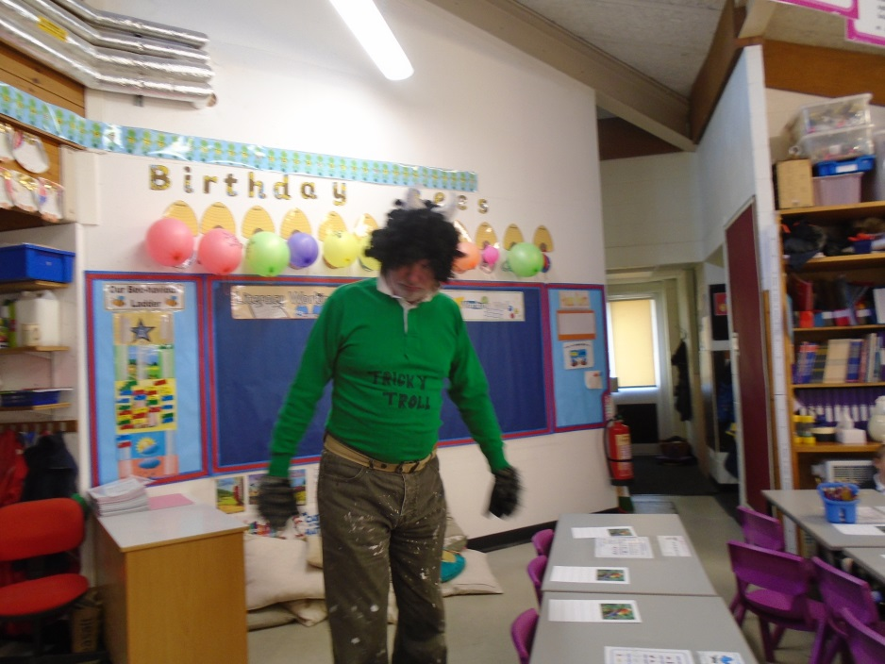
A visit from the Phonic fairy and tricky word troll!

Slide 8
The phonic fairy
At the start of each lesson the children are introduced to the sound that they are learning and the book.
As you can see the lessons are really fun and engaging, the teachers love dressing up (even Mr Mills!).

Slide 9
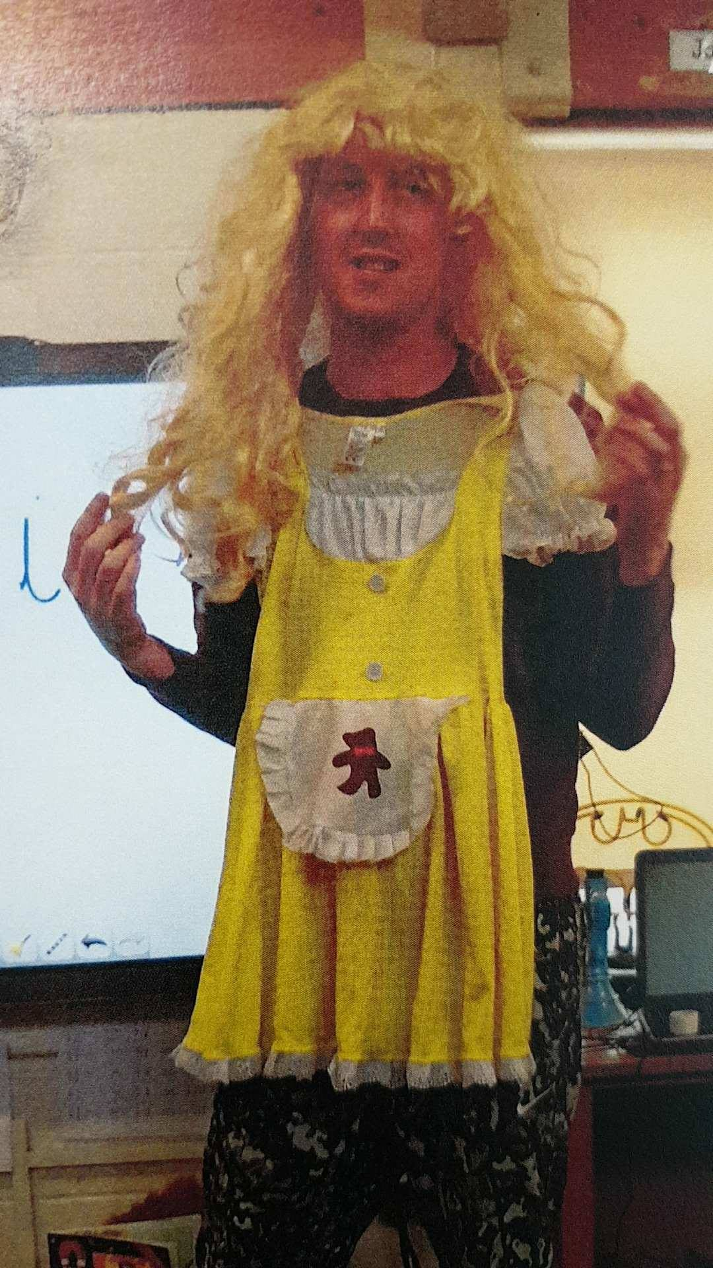

Slide 10
The sounds…
https://www.youtube.com/watch?v=RlpsmpWOUFY
This is not all the sounds but most of them.
At school to help the children to remember the sounds there are specific captions and actions that we use similar to Jolly Phonics and Letters and sounds.
We have been using them this year and the children really them.
To help the children decode and then re-blend the words, we are using “phoneme fingers” – cue example Miss Hammond.

Slide 11
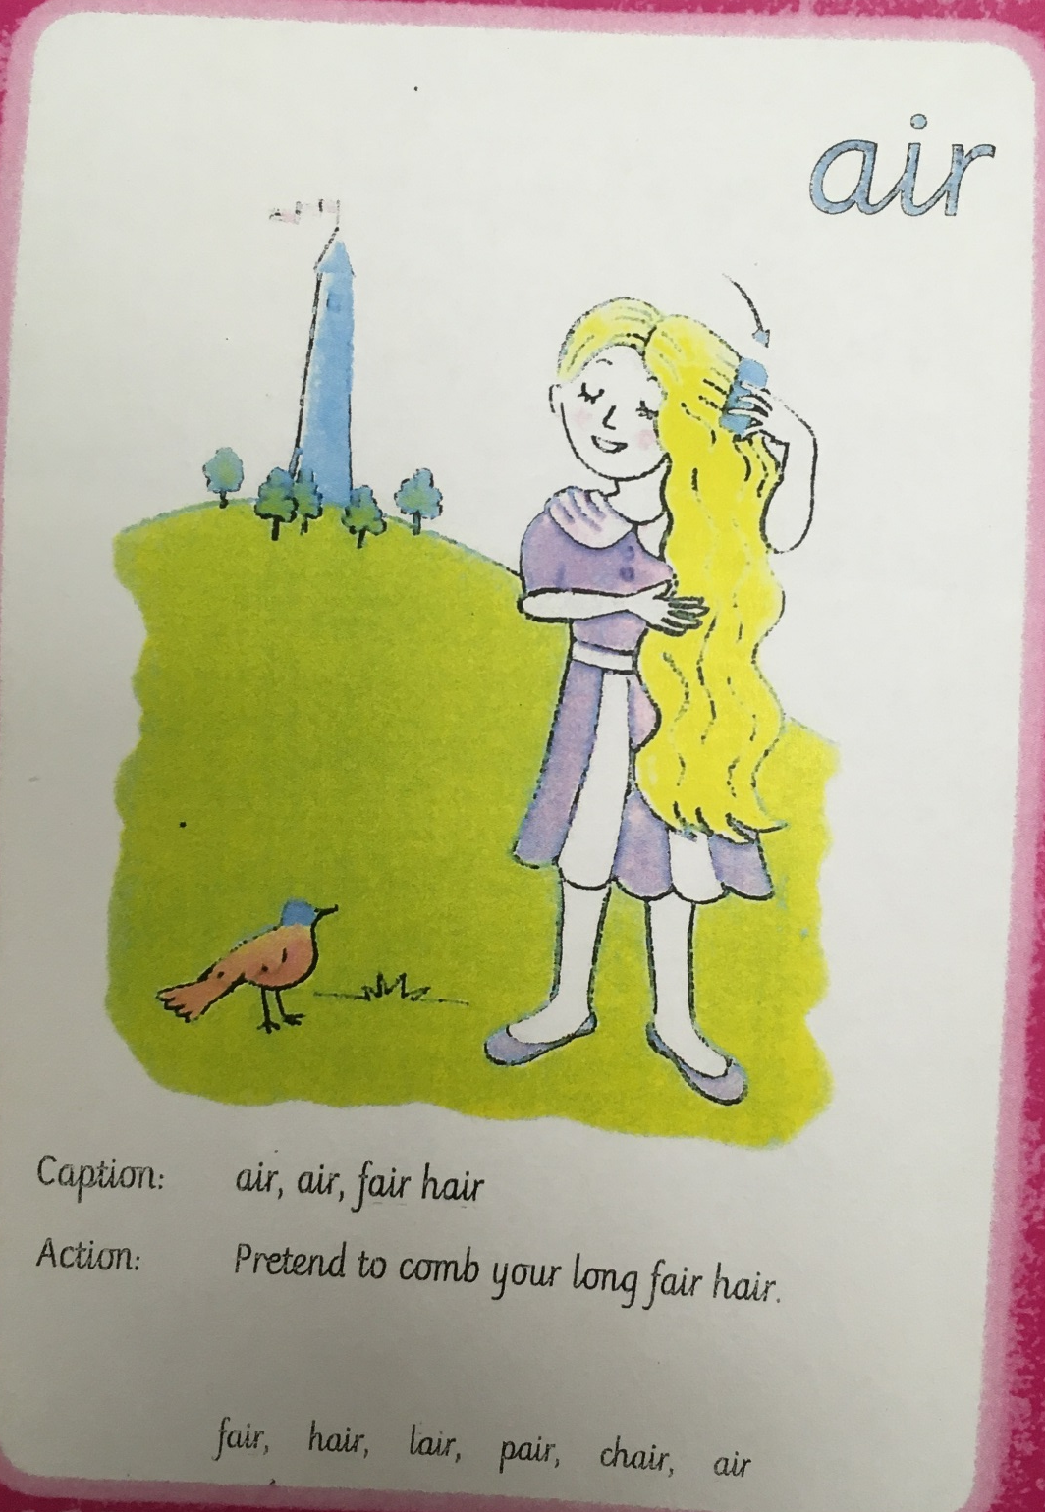

Slide 12
How a lesson works…
The class teacher will dress up as a character from the book and “wow” the children.
The class teacher will then read the story with the focus sound within it. He/she will make continual reference to the focus sound whilst reading the story.
Class teacher will then write words on the board asking the children to recognise the sound we are focussing on whilst moving around the classroom discussing with their peers.
Children to then write sound buttons and zips underneath the words written by the class teacher.
Whole class to use phoneme fingers to segment the word and then re-blend.
Class teacher to dismiss children to differentiated contextual activities based upon the focus book. For example threading Rapunzel’s golden hair into words containing the choses phoneme – “ir”

Slide 13
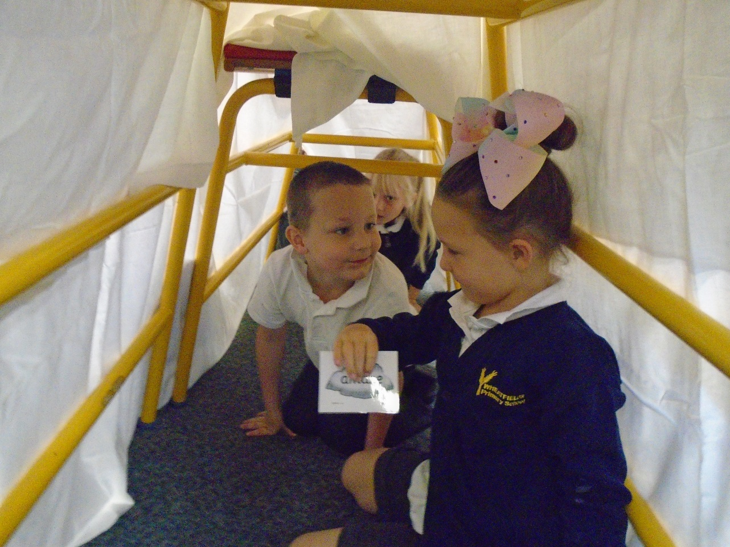
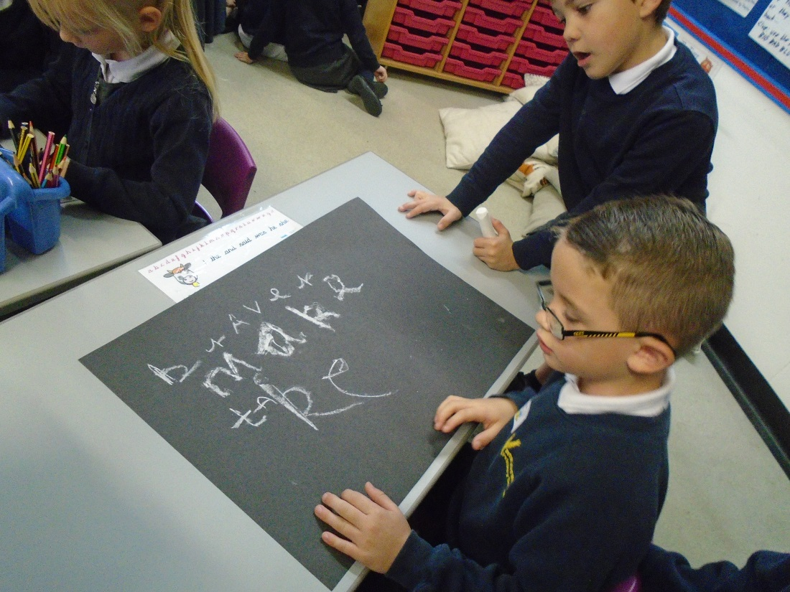

Slide 14
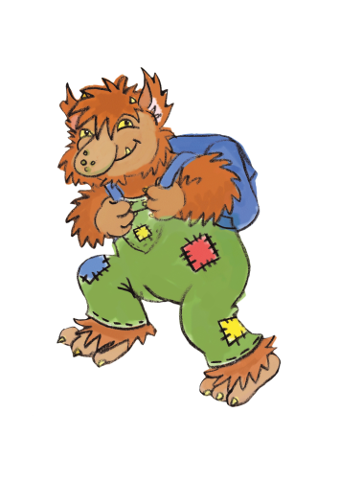
The tricky word troll
Not all words fit with phonics such as ‘to’ ‘was’ ‘he’
These are known a tricky words and we just have to learn them.
The Tricky Word Troll likes to try and catch the children out. Each class has a Tricky Word Troll that helps them learn to read these words.

Slide 15
How you can help at home
Reading every day will help encourage your child to use the sounds that they are learning as well as improving their confidence. It will instil a love of books and learning.
Practising the sounds and the actions, then using them in context. This can be done through games and at any time in the day.
Reading is everywhere (shops, road signs ect.) so encourage them to use their phonics when out and about.

Slide 16
Glossary
Phoneme – individual sounds
Grapheme – letters that create a sound
Diagraph – two letters that make a sound ‘ai’
Tri-graph – three letters that make a sound ‘igh’
Split vowel diagraph – a_e, e_e, i_e, o_e, u_e
Segment – split a word into its sounds
Blend – putting the sounds in a word together
Pseudo – a made up word
Non-pseudo – real word

